Slide 1
Operation and Maintenance
Manual Track down

Slide 2
Types of Manuals
Engineer Produced Manuals
Manufacture Produced Manuals

Slide 3
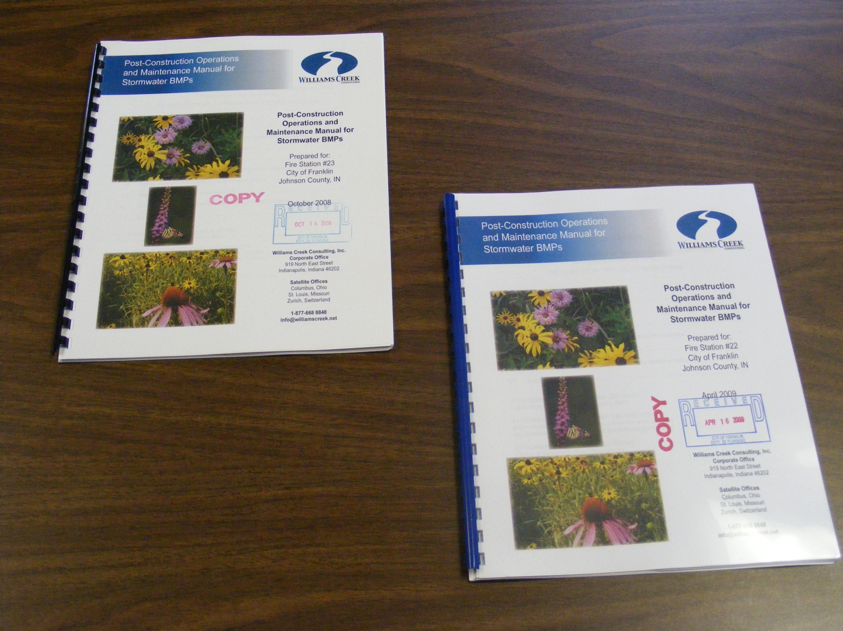
Examples of Engineers Produced Manuals

Slide 4
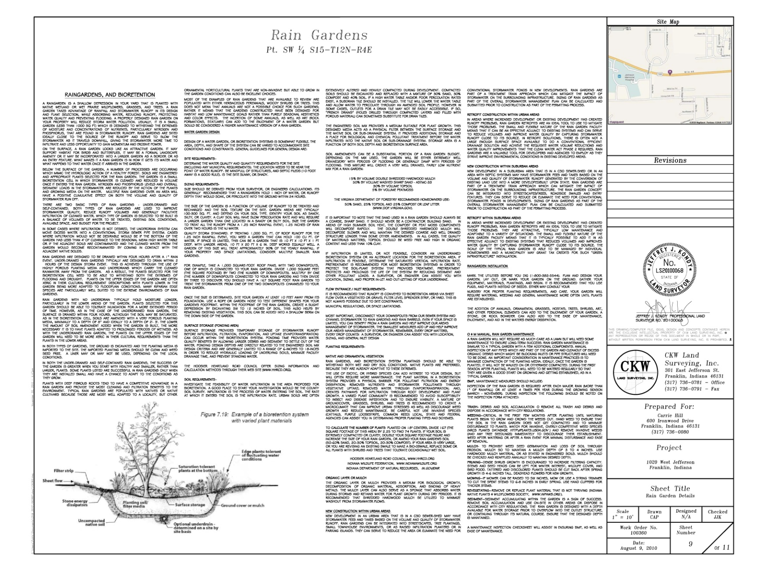
More Examples of Engineer Produced Manuals

Slide 5
Manufactured Produced Manual

Slide 6

Example of Manufactured Manual

Slide 7
Inspection and Inventory of BMP’s

Slide 8
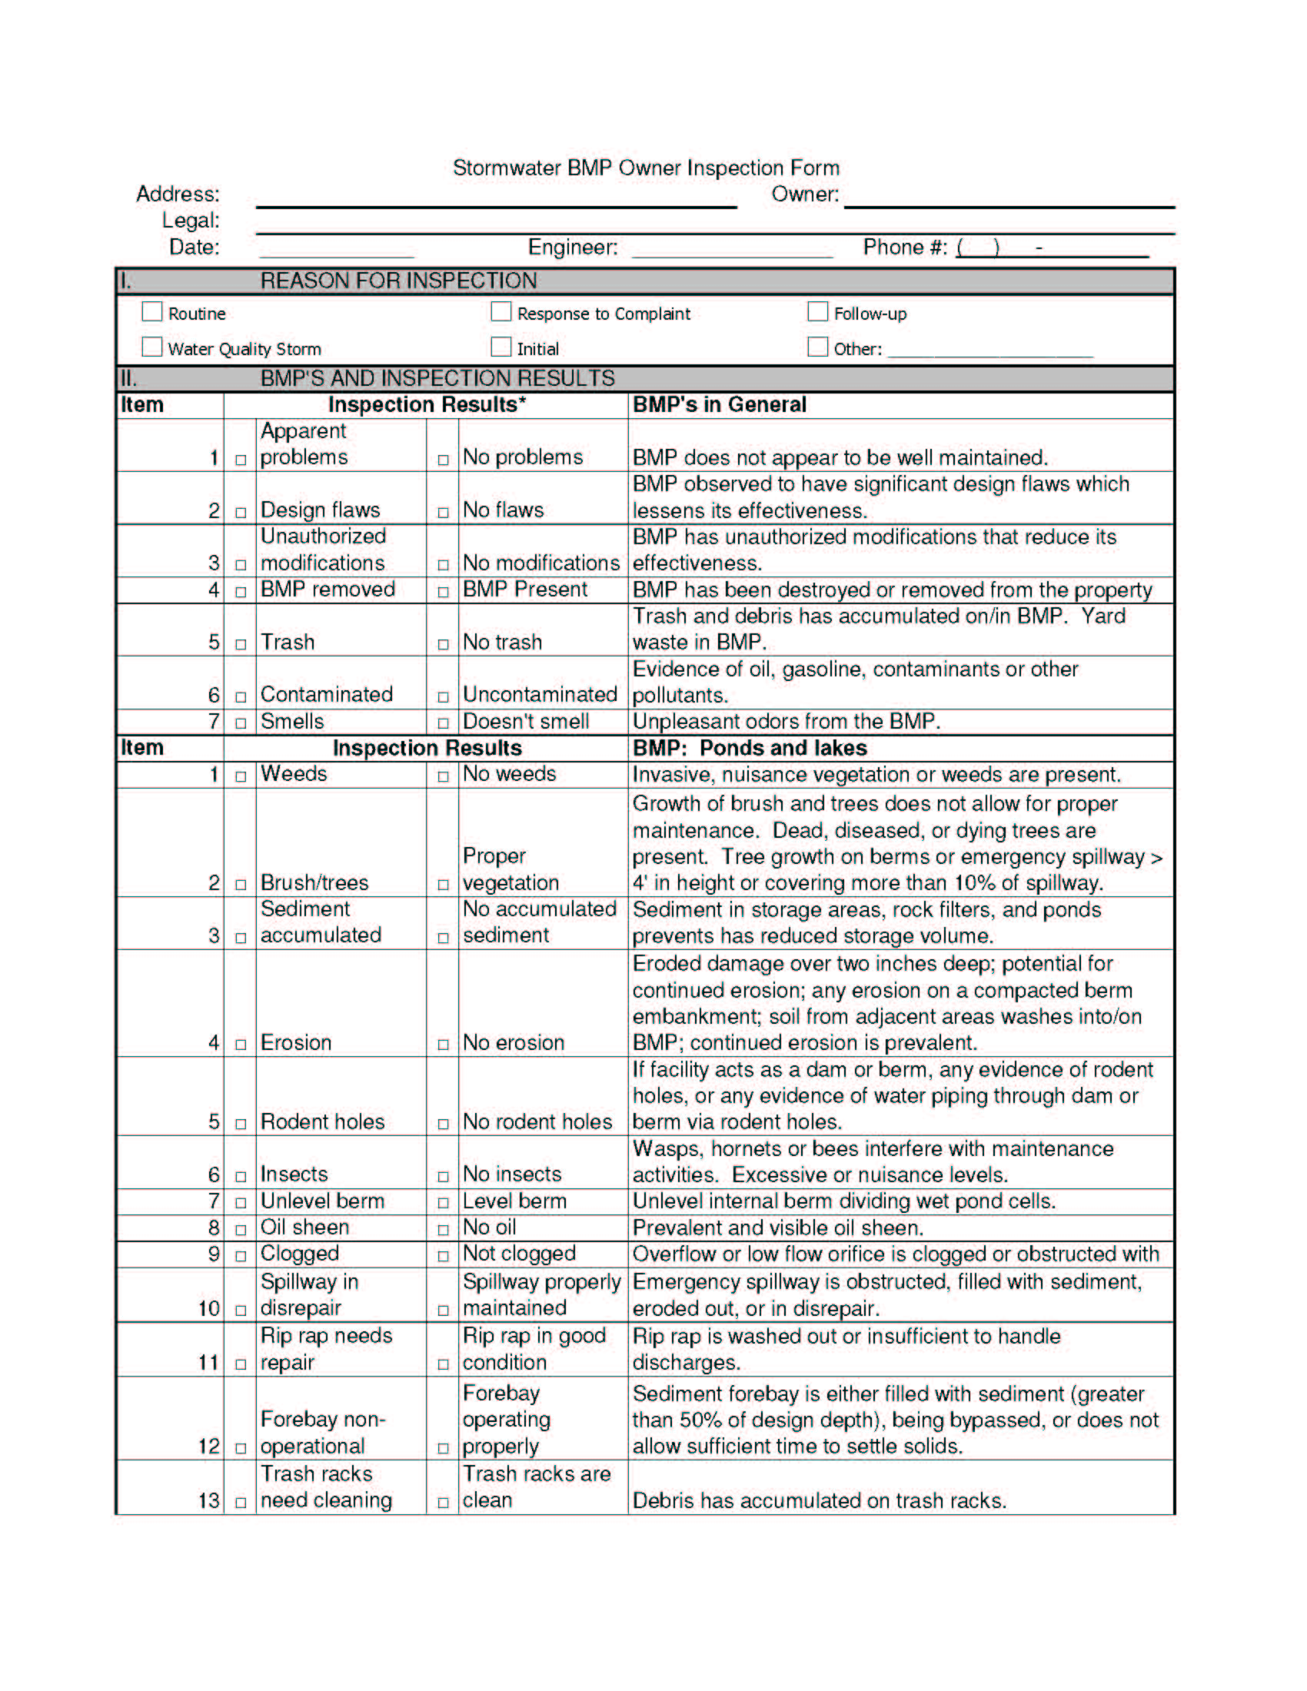
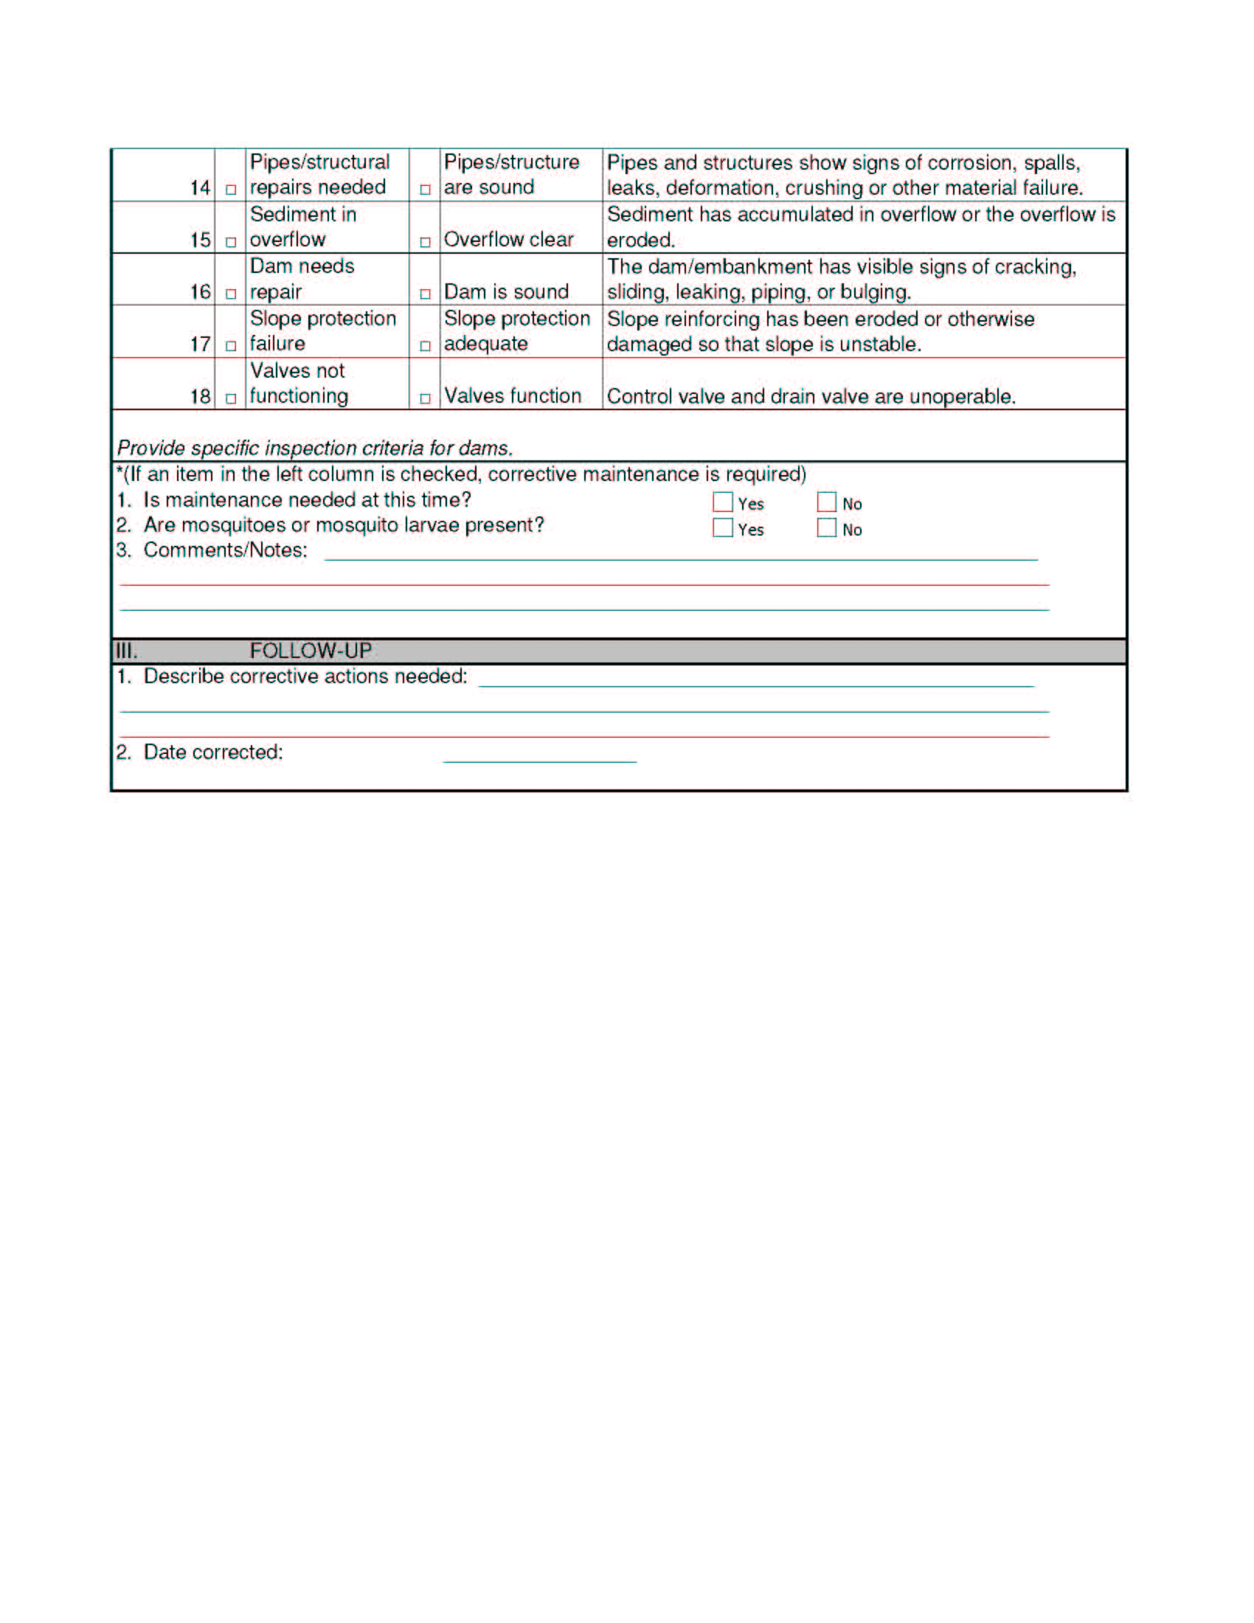
Inspection Forms

Slide 9
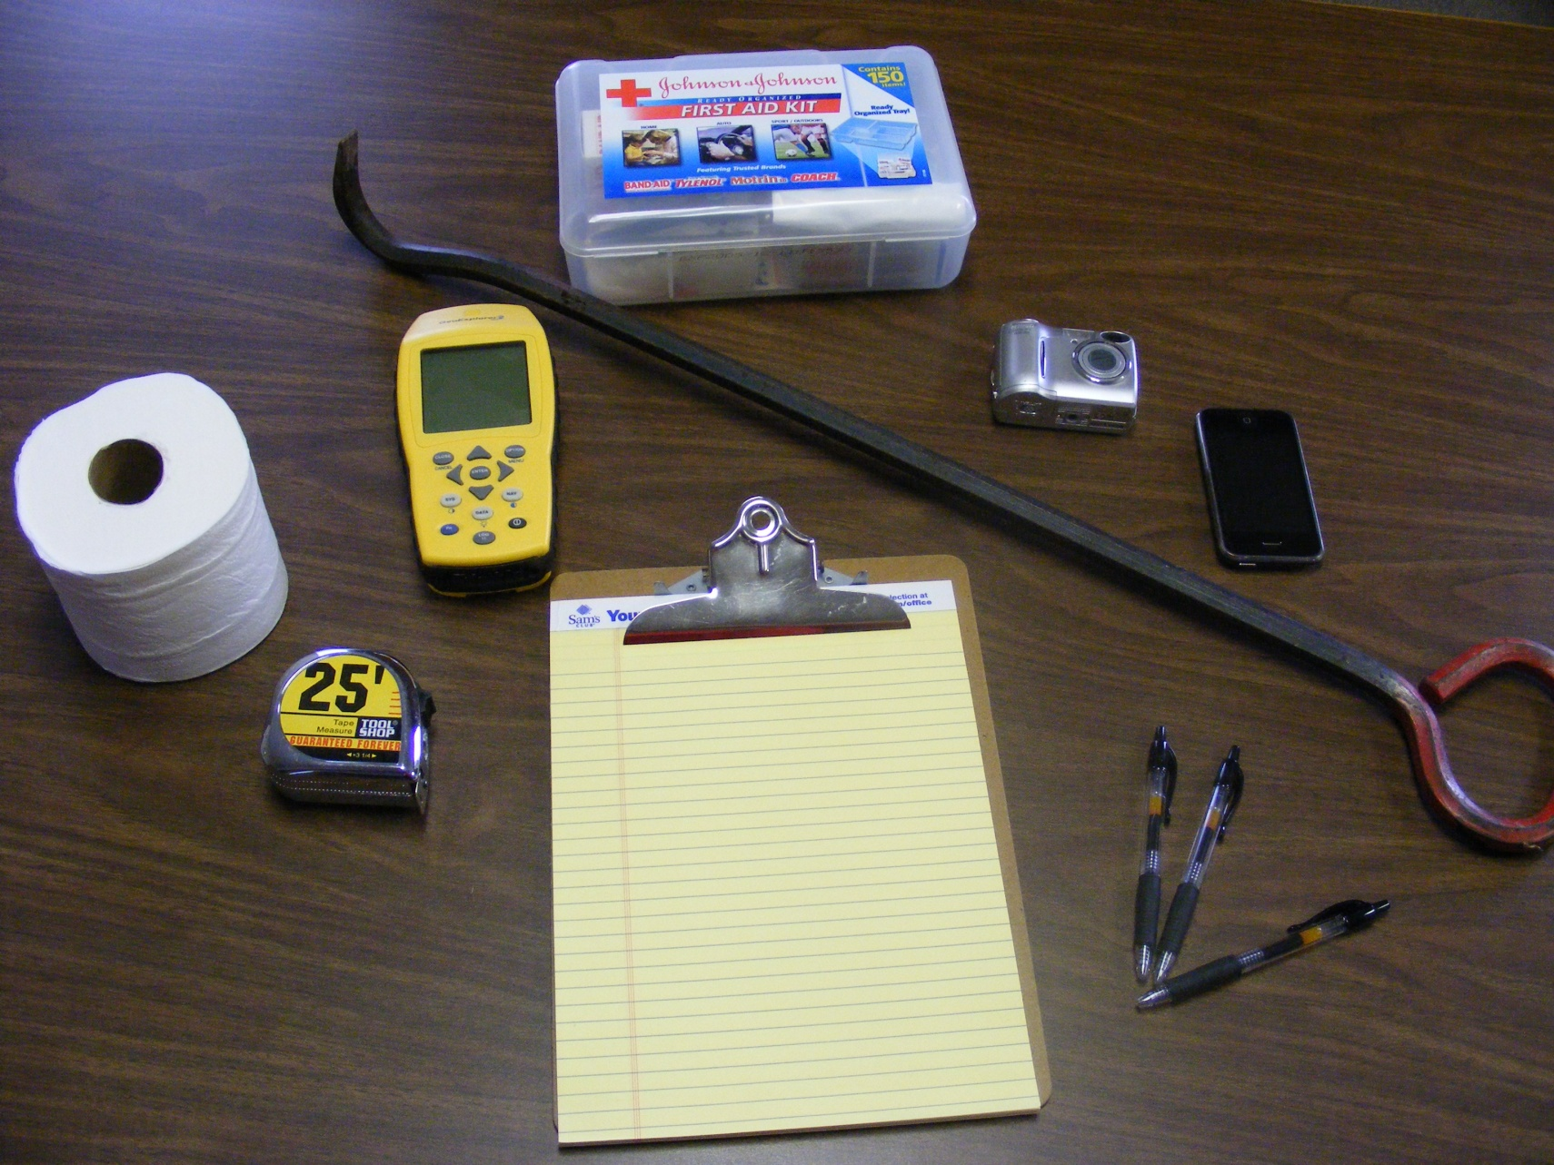
Inspection Tools

Slide 10


Slide 11


Slide 12


Slide 13
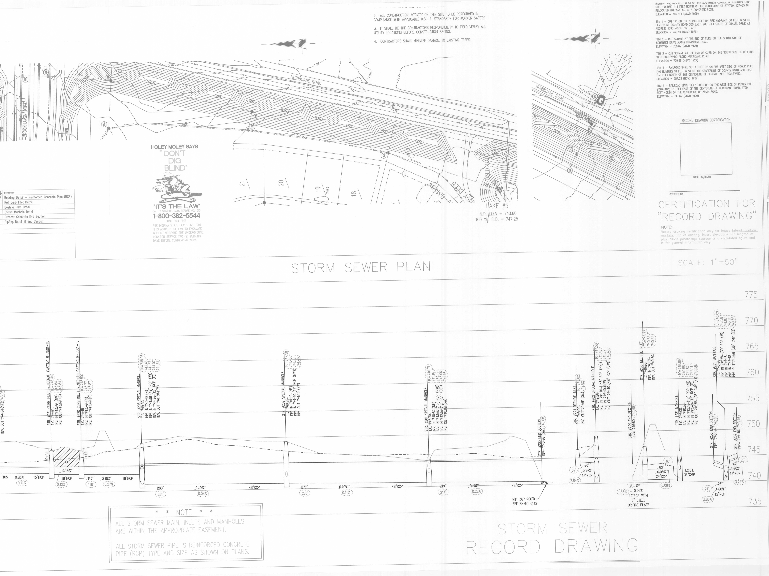

Slide 14
